Slide 1
Lectures 11-14 Combinatorics
N D Gangadhar

Slide 2
Intended Learning Outcomes
At the end of the lectures, the student will be able to
Describe the basic rules of counting
Explain and apply the Pigeonhole Principle
Solve permutations and combinations counting problems
Explain binomial coefficients and their identities

Slide 3
Topics
Basics of Counting
Pigeonhole Principle
Permutations and Combinations
Binomial Coefficients and Identities

Slide 4
Section 1: Basics of Counting

Slide 5
Section Outline
The Product Rule
The Sum Rule
The Subtraction Rule (Principle of Inclusion-Exclusion)

Slide 6
Basic Counting Principles: The Product Rule
The Product Rule: A procedure can be broken down into a sequence of two tasks. There are n₁ ways to do the first task and n₂ ways to do the second task. Then there are n₁∙n₂ ways to do the procedure.
Example: How many bit strings of length seven are there?
Solution: Since each of the seven bits is either a 0 or a 1, the answer is 2⁷ = 128.

Slide 7
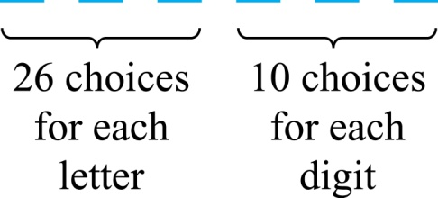
The Product Rule
Example: How many different license plates can be made if each plate contains a sequence of three uppercase English letters followed by three digits?
Solution: By the product rule, there are
26 ∙ 26 ∙ 26 ∙ 10 ∙ 10 ∙ 10 = 17,576,000
different possible license plates.

Slide 8
Counting Functions
Counting Functions: How many functions are there from a set with m elements (domain) to a set with n elements (codomain)?
Solution: Since a function represents a choice of one of the n elements of the codomain for each of the m elements in the domain, the product rule tells us that there are n ∙ n ∙ ∙ ∙ n = n^{m} such functions.
Counting One-to-One Functions: How many one-to-one functions are there from a set with m elements to one with n elements?
Solution: Suppose the elements in the domain are a₁, a₂,…, a_{m}. There are n ways to choose the value of a₁ and n−1 ways to choose a₂, etc. The product rule tells us that there are n(n−1) (n−2)∙∙∙(n−m +1) such functions.

Slide 9
Telephone Numbering Plan
Example: The North American numbering plan (NANP) specifies that a telephone number consists of 10 digits, consisting of a three-digit area code, a three-digit office code, and a four-digit station code. There are some restrictions on the digits.
Let X denote a digit from 0 through 9.
Let N denote a digit from 2 through 9.
Let Y denote a digit that is 0 or 1.
In the old plan (in use in the 1960s) the format was NYX-NNX-XXXX.
In the new plan, the format is NXX-NXX-XXXX.
How many different telephone numbers are possible under the old plan and the new plan?

Slide 10
Telephone Numbering Plan
Example: The North American numbering plan (NANP) specifies that a telephone number consists of 10 digits, consisting of a three-digit area code, a three-digit office code, and a four-digit station code. There are some restrictions on the digits.
Let X denote a digit from 0 through 9.
Let N denote a digit from 2 through 9.
Let Y denote a digit that is 0 or 1.
In the old plan (in use in the 1960s) the format was NYX-NNX-XXXX.
In the new plan, the format is NXX-NXX-XXXX.
How many different telephone numbers are possible under the old plan and the new plan?
Solution: Use the Product Rule.
There are 8 ∙2 ∙10 = 160 area codes with the format NYX.
There are 8 ∙10 ∙10 = 800 area codes with the format NXX.
There are 8 ∙8 ∙10 = 640 office codes with the format NNX.
There are 10 ∙10 ∙10 ∙10 = 10,000 station codes with the format XXXX.
Number of old plan telephone numbers: 160 ∙640 ∙10,000 = 1,024,000,000.
Number of new plan telephone numbers: 800 ∙800 ∙10,000 = 6,400,000,000.

Slide 11
Counting Subsets of a Finite Set
Counting Subsets of a Finite Set: Use the product rule to show that the number of different subsets of a finite set S is 2^{|S|}. (Mathematical induction can be used to prove this same result.)
Solution: List the elements of S in an (arbitrary) order. Then, there is a one-to-one correspondence between subsets of S and bit strings of length |S|. When the ith element is in the subset, the bit string has a 1 in the ith position and a 0 otherwise.
By the product rule, there are 2^{|S|} such bit strings, and therefore 2^{|S|} subsets.

Slide 12
Product Rule in Terms of Sets
If A₁, A₂, … , A_{m} are finite sets, then the number of elements in the Cartesian product of these sets is the product of the number of elements of each set.
The task of choosing an element in the Cartesian product A₁ ⨉ A₂ ⨉ ∙∙∙ ⨉ A_{m} is done by choosing an element in A₁, an element in A₂ , …, and an element in A_{m}.
By the product rule, it follows that:
|A₁ ⨉ A₂ ⨉ ∙∙∙ ⨉ A_{m} |= |A₁| ∙ |A₂| ∙ ∙∙∙ ∙ |A_{m}|.

Slide 13
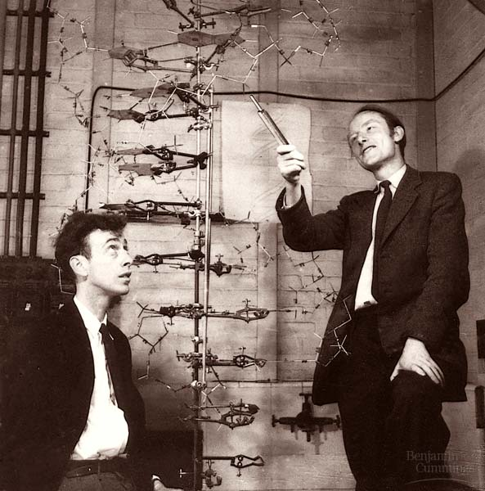
Counting and DNA: DNA structure discovered in 1953 by Watson and Crick

Slide 14
DNA Structure

Slide 15
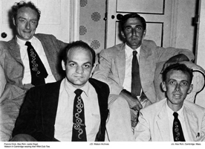
RNA Structure Problem
There are 20 aminoacids that build up proteins
1954 “Solve the riddle of the RNA structure and to understand how it builds proteins” (Clockwise from upper left: Francis Crick, L. Orgel, James Watson, Al. Rich)

Slide 16
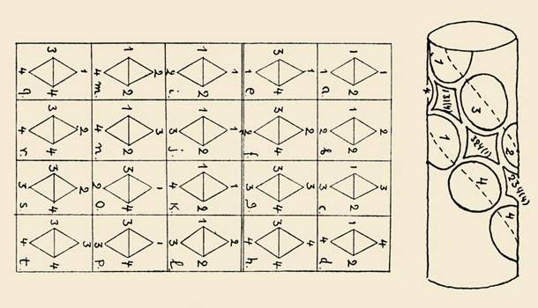
The Diamond Code
G. Gamow - Double stranded DNA acts as a template for protein synthesis: various combinations of bases could form distinctively shaped cavities into which the side chains of aminoacids might fit; 24-4 = 20

Slide 17
Comma-free Codes
Crick’s 1957 model of protein synthesis
Construct a code in which when two sense codons (triplets) are catenated, the subword codons are nonsense codons
If CGU and AAG are sense codons, then GUA and UAA must be nonsense because they appear in CGUAAG

Slide 18
Comma-free Codes
How many words can a comma-free code include?
How many maximal comma-free codes there are?
For an alphabet of n letters grouped into k-letter words, if k is prime, the number of maximal comma-free codes is (n^k –n)/k
For n=4 and k=3 this equals 408
For n=4 and k=3 the size of a maximal comma-free code is the magic number 20

Slide 19
Genetic Code is NOT Comma-free
News from the lab bench: Nirenberg, and Matthaei 1961 synthesized RNA, namely poly-U, coding for phenylalanine
Therefore the genetic code is not a comma-free code
By 1965 the genetic code was solved
The code resembled none of the theoretical notions
The “extra” codons are merely redundant

Slide 20
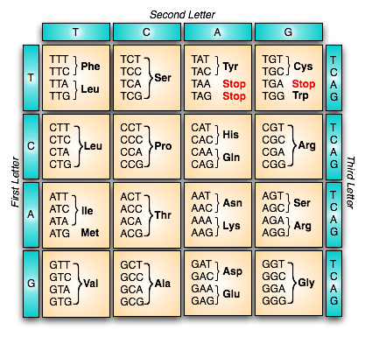
The Genetic Code

Slide 21
DNA and Genomes
A gene is a segment of a DNA molecule that encodes a particular protein and the entirety of genetic information of an organism is called its genome.
The DNA of bacteria has between 10⁵ and 10⁷ nucleotides.
Mammal genomes range between 10⁸ and 10¹⁰ nucleotides.
By the product rule there are at least 4¹⁰⁵ possible different DNA sequences for bacteria, and 4¹⁰⁸ possible different DNA sequences for mammals.
This may explain the tremendous variability among living organisms.
The human genome includes approximately 23,000 genes, each having a length of 1,000 or more nucleotides.
Biologists, mathematicians, and computer scientists all work on determining the DNA sequence (genome) of different organisms.

Slide 22
Basic Counting Principles: The Sum Rule
The Sum Rule: If a task can be done either in one of n₁ ways or in one of n₂ ways, where none of the set of n₁ ways is the same as any of the n₂ ways, then there are n₁ + n₂ ways to do the task.
Example: The mathematics department must choose either a student or a faculty member as a representative for a university committee. How many choices are there for this representative if there are 37 members of the mathematics faculty and 83 mathematics majors and no one is both a faculty member and a student.
Solution: By the sum rule it follows that there are 37 + 83 = 120 possible ways to pick a representative.

Slide 23
The Sum Rule in Terms of Sets
The sum rule can be phrased in terms of sets:
|A ∪ B|= |A| + |B|
as long as A and B are disjoint sets.
Or more generally,
|A₁ ∪ A₂ ∪ ∙∙∙ ∪ A_{m} |= |A₁| + |A₂| + ∙∙∙ + |A_{m}|
when A_{i} ∩ A_{j} = ∅ for all i, j.
The case where the sets have elements in common will be discussed when we consider the subtraction rule.

Slide 24
Combining the Sum and Product Rule
Example: Suppose statement labels in a programming language can be either a single letter or a letter followed by a digit. Find the number of possible labels.
Solution: Use the product rule.
26 + 26 ∙ 10 = 286

Slide 25
Counting Passwords
Combining the sum and product rule allows us to solve more complex problems.
Example: Each user on a computer system has a password, which is six to eight characters long, where each character is an uppercase letter or a digit. Each password must contain at least one digit. How many possible passwords are there?

Slide 26
Counting Passwords
Example: Each user on a computer system has a password, which is six to eight characters long, where each character is an uppercase letter or a digit. Each password must contain at least one digit. How many possible passwords are there?
Solution: Let P be the total number of passwords, and let P₆, P₇, and P₈ be the passwords of length 6, 7, and 8.
By the sum rule P = P₆ + P₇ +P₈.
To find each of P₆, P₇, and P₈ , we find the number of passwords of the specified length composed of letters and digits and subtract the number composed only of letters. We find that:
P₆ = 36⁶ − 26⁶ =2,176,782,336 − 308,915,776 =1,867,866,560.
P₇ = 36⁷ − 26⁷ =
78,364,164,096 − 8,031,810,176 = 70,332,353,920.
P₈ = 36⁸ − 26⁸ =
2,821,109,907,456 − 208,827,064,576 =2,612,282,842,880.
Consequently, P = P₆ + P₇ +P₈ = 2,684,483,063,360.

Slide 27
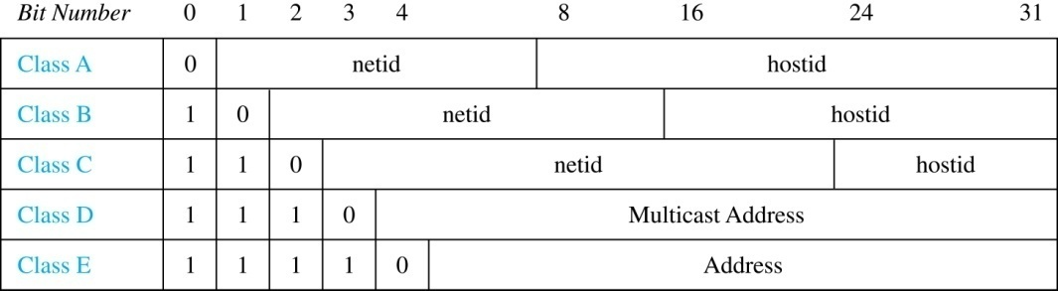
Internet Addresses
Version 4 of the Internet Protocol (IPv4) uses 32 bits.
Class A Addresses: used for the largest networks, a 0,followed by a 7-bit netid and a 24-bit hostid, or
Class B Addresses: used for the medium-sized networks, a 10,followed by a 14-bit netid and a 16-bit hostid, or
Class C Addresses: used for the smallest networks, a 110,followed by a 21-bit netid and a 8-bit hostid.
Neither Class D nor Class E addresses are assigned as the address of a computer on the internet. Only Classes A, B, and C are available.
1111111 is not available as the netid of a Class A network.
Hostids consisting of all 0s and all 1s are not available in any network.

Slide 28
Counting Internet Addresses
Example: How many different IPv4 addresses are available for computers on the internet?

Slide 29
Counting Internet Addresses
Example: How many different IPv4 addresses are available for computers on the internet?
Solution: Use both the sum and the product rule. Let x be the number of available addresses, and let x_{A}, x_{B}, and x_{C} denote the number of addresses for the respective classes.
To find, x_{A}: 2⁷ − 1 = 127 netids. 2²⁴ − 2 = 16,777,214 hostids.
x_{A} = 127∙ 16,777,214 = 2,130,706,178.
To find, x_{B}: 2¹⁴ = 16,384 netids. 2¹⁶ − 2 = 16,534 hostids.
x_{B} = 16,384 ∙ 16, 534 = 1,073,709,056.
To find, x_{C}: 2²¹ = 2,097,152 netids. 2⁸ − 2 = 254 hostids.
x_{C} = 2,097,152 ∙ 254 = 532,676,608.
Hence, the total number of available IPv4 addresses is
x = x_{A} + x_{B} + x_{C}
= 2,130,706,178 + 1,073,709,056 + 532,676,608
= 3, 737,091,842.
Not Enough Today !!
The newer IPv6 protocol solves the problem of too few addresses.

Slide 30
Basic Counting Principles: Subtraction Rule
Subtraction Rule: If a task can be done either in one of n₁ ways or in one of n₂ ways, then the total number of ways to do the task is n₁ + n₂ minus the number of ways to do the task that are common to the two different ways.
Also known as the principle of inclusion-exclusion:

Slide 31
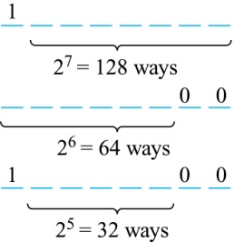
Counting Bit Strings
Example: How many bit strings of length eight either start with a 1 bit or end with the two bits 00?
Solution: Use the subtraction rule.
Number of bit strings of length eight that start with a 1 bit: 2⁷ = 128
Number of bit strings of length eight that start with bits 00: 2⁶ = 64
Number of bit strings of length eight that start with a 1 bit and end with bits 00 : 2⁵ = 32
Hence, the number is 128 + 64 − 32 = 160.

Slide 32
Section 2: The Pigeonhole Principle

Slide 33
Section Outline
The Pigeonhole Principle
Generalized Pigeonhole Principle

Slide 34
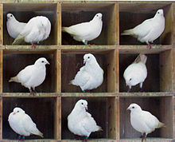
Pigeonhole Principle

Slide 35
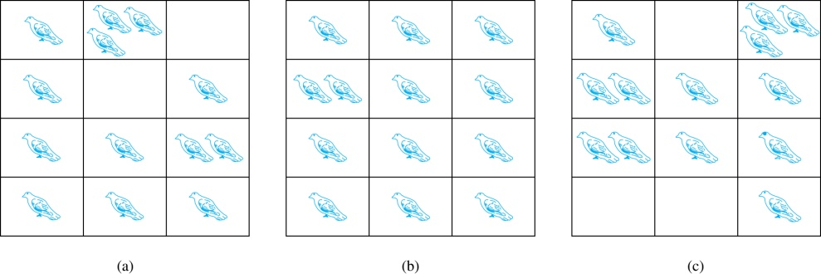
Pigeonhole Principle
If a flock of 20 pigeons roosts in a set of 19 pigeonholes, one of the pigeonholes must have more than 1 pigeon.
Pigeonhole Principle: If k is a positive integer and k + 1 objects are placed into k boxes, then at least one box contains two or more objects.
Proof: We use a proof by contraposition. Suppose none of the k boxes has more than one object. Then the total number of objects would be at most k. This contradicts the statement that we have k + 1 objects.

Slide 36
Pigeonhole Principle
Example: Among any group of 367 people, there must be at least two with the same birthday, because there are only 366 possible birthdays.
Example: Show that for every integer n there is a multiple of n that has only 0s and 1s in its decimal expansion.

Slide 37
Pigeonhole Principle
Example: Among any group of 367 people, there must be at least two with the same birthday, because there are only 366 possible birthdays.
Example : Show that for every integer n there is a multiple of n that has only 0s and 1s in its decimal expansion.
Solution: Let n be a positive integer. Consider the n + 1 integers 1, 11, 111, …., 11…1 (where the last has n + 1 digits ``1``). There are n possible remainders when an integer is divided by n. By the pigeonhole principle, when each of the n + 1 integers is divided by n, at least two must have the same remainder. Subtract the smaller from the larger and the result is a multiple of n that has only 0s and 1s in its decimal expansion.

Slide 38

Pigeonhole Principle in Literature
“And NUH is the letter I use to spell Nutches
Who live in small caves, known as Nitches, for hutches,
These Nutches have troubles, the biggest of which is
the fact there are many more Nutches than Nitches.
Each Nutch in a Nitch knows that some other Nutch
Would like to move into his Nitch very much.
So each Nutch in a Nitch has to watch that small Nitch
Or Nutches who haven’t got Nitches will snitch. “
Dr. Seuss, On Beyond Zebra

Slide 39
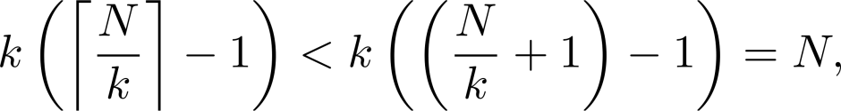
The Generalized Pigeonhole Principle
The Generalized Pigeonhole Principle: If N objects are placed into k boxes, then there is at least one box containing at least ⌈N/k⌉ objects.
Proof: We use a proof by contraposition. Suppose that none of the boxes contains more than ⌈N/k⌉ − 1 objects. Then the total number of objects is at most
where the inequality ⌈N/k⌉ < (N/k) + 1 has been used. This is a contradiction because there are a total of n objects.
Example: Among 100 people there are at least ⌈100/12⌉ = 9 who were born in the same month.
Notes:
X leq ceiling(x) < X+1 and x-1 < floor (x) leq x ; The number of objects exceeds a multiple of the number of boxes.

Slide 40
The Generalized Pigeonhole Principle
Example: a) How many cards must be selected from a standard deck of 52 cards to guarantee that at least three cards of the same suit are chosen?

Slide 41
The Generalized Pigeonhole Principle
Example: a) How many cards must be selected from a standard deck of 52 cards to guarantee that at least three cards of the same suit are chosen?
Solution: a) We assume four boxes; one for each suit. Using the generalized pigeonhole principle, at least one box contains at least ⌈N/4⌉ cards. At least three cards of one suit are selected if ⌈N/4⌉ ≥3. The smallest integer N such that ⌈N/4⌉ ≥3 is
N = 2 ∙ 4 + 1 = 9.

Slide 42
Section 3: Permutations and Combinations

Slide 43
Section Outline
Permutations
Combinations

Slide 44
Permutations
Definition: A permutation of a set of distinct objects is an ordered arrangement of these objects. An ordered arrangement of r elements of a set is called an r-permutation.
Example: Let S = {1,2,3}.
The ordered arrangement 3,1,2 is a permutation of S.
The ordered arrangement 3,2 is a 2-permutation of S.
The number of r-permutations of a set with n elements is denoted by P(n,r).
The 2-permutations of S = {1,2,3} are 1,2; 1,3; 2,1; 2,3; 3,1; and 3,2. Hence, P(3,2) = 6.

Slide 45
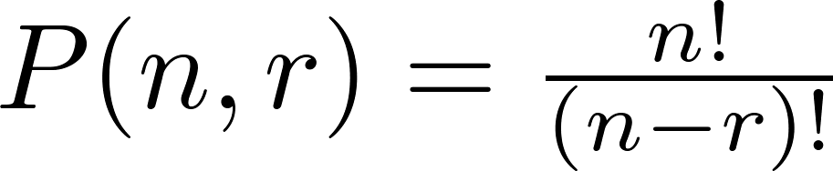
A Formula for the Number of Permutations
Theorem: If n is a positive integer and r is an integer with 1 ≤ r ≤ n, then there are
P(n, r) = n(n − 1)(n − 2) ∙∙∙ (n − r + 1)
r-permutations of a set with n distinct elements.
Note that P(n,0) = 1, since there is only one way to order zero elements.
Proof: Use the product rule. The first element can be chosen in n ways. The second in n − 1 ways, and so on until there are (n − ( r − 1)) ways to choose the last element.
Corollary: If n and r are integers with 1 ≤ r ≤ n, then

Slide 46
Solving Counting Problems by Counting Permutations
Example: How many ways are there to select a first-prize winner, a second prize winner, and a third-prize winner from 100 different people who have entered a contest?
Solution:
P(100,3) = 100 ∙ 99 ∙ 98 = 970,200

Slide 47
Solving Counting Problems by Counting Permutations
Example: Suppose that a saleswoman has to visit eight different cities. She must begin her trip in a specified city, but she can visit the other seven cities in any order she wishes. How many possible orders can the saleswoman use when visiting these cities?

Slide 48
Solving Counting Problems by Counting Permutations
Example: Suppose that a saleswoman has to visit eight different cities. She must begin her trip in a specified city, but she can visit the other seven cities in any order she wishes. How many possible orders can the saleswoman use when visiting these cities?
Solution: The first city is chosen, and the rest are ordered arbitrarily. Hence the orders are:
P(7, 7) = 7! = 7 ∙ 6 ∙ 5 ∙ 4 ∙ 3 ∙ 2 ∙ 1 = 5040
If she wants to find the tour with the shortest path that visits all the cities, she must consider 5040 paths!

Slide 49
Solving Counting Problems by Counting Permutations
Example: How many permutations of the letters ABCDEFGH contain the string ABC?

Slide 50
Solving Counting Problems by Counting Permutations
Example: How many permutations of the letters ABCDEFGH contain the string ABC ?
Solution: We solve this problem by counting the permutations of six objects, ABC, D, E, F, G, and H.
6! = 6 ∙ 5 ∙ 4 ∙ 3 ∙ 2 ∙ 1 = 720

Slide 51

Combinations
Definition: An r-combination of elements of a set is an unordered selection of r elements from the set. Thus, an r-combination is simply a subset of the set with r elements.
The number of r-combinations of a set with n distinct elements is denoted by C(n, r). The notation is also used and is called a binomial coefficient. (We will see this notation again in the binomial theorem.)
Example: Let S be the set {a, b, c, d}. Then {a, c, d} is a 3-combination from S. It is the same as {d, c, a} since the order listed does not matter.
C(4,2) = 6 because the 2-combinations of {a, b, c, d} are the six subsets {a, b}, {a, c}, {a, d}, {b, c}, {b, d}, and {c, d}.

Slide 52
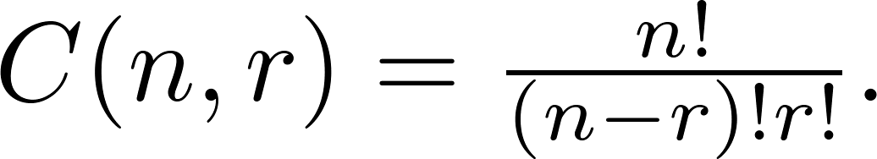
Combinations
Theorem 2: The number of r-combinations of a set with n elements, where n ≥ r ≥ 0, equals
Proof: By the product rule P(n, r) = C(n,r) ∙ P(r,r). Therefore,

Slide 53
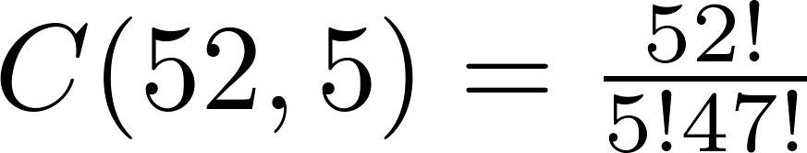
Combinations
Example: How many poker hands of five cards can be dealt from a standard deck of 52 cards? Also, how many ways are there to select 47 cards from a deck of 52 cards?
Solution: Since the order in which the cards are dealt does not matter, the number of five card hands is:
The different ways to select 47 cards from 52 is
This is a special case of a general result. →

Slide 54
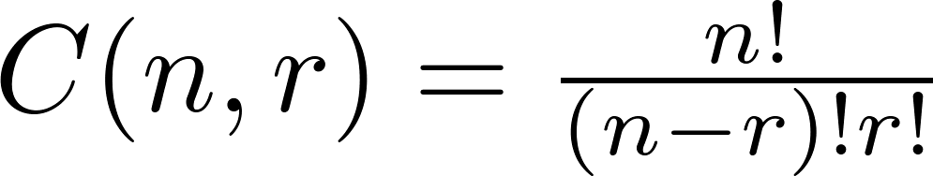
Combinations
Corollary 2: Let n and r be nonnegative integers with r ≤ n. Then C(n, r) = C(n, n − r).
Proof: From Theorem 2, it follows that
and
Hence, C(n, r) = C(n, n − r).

Slide 55
Combinations
Example: How many ways are there to select five players from a 10-member tennis team to make a trip to a match at another school.
Example: A group of 30 people have been trained as astronauts to go on the first mission to Mars. How many ways are there to select a crew of six people to go on this mission?

Slide 56
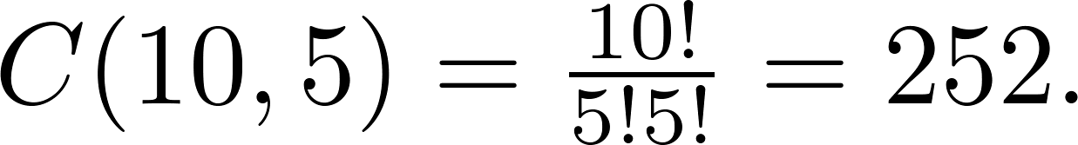
Combinations
Example: How many ways are there to select five players from a 10-member tennis team to make a trip to a match at another school.
Solution: By Theorem 2, the number of combinations is
Example: A group of 30 people have been trained as astronauts to go on the first mission to Mars. How many ways are there to select a crew of six people to go on this mission?
Solution: By Theorem 2, the number of possible crews is

Slide 57
Section 6: Binomial Coefficients and Identities

Slide 58
Section Outline
Binomial Theorem
Pascal’s Identity and Triangle

Slide 59


Powers of Binomial Expressions
Definition: A binomial expression is the sum of two terms, such as x + y. (More generally, these terms can be products of constants and variables.)
We can use counting principles to find the coefficients in the expansion of (x + y)^{n} where n is a positive integer.
To illustrate this idea, we first look at the process of expanding (x + y)³.
(x + y) (x + y) (x + y) expands into a sum of terms that are the product of a term from each of the three sums.
Terms of the form x³, x²y, x y², y³ arise. The question is what are the coefficients?
To obtain x³ , an x must be chosen from each of the sums. There is only one way to do this. So, the coefficient of x³ is 1.
To obtain x²y, an x must be chosen from two of the sums and a y from the other. There are ways to do this and so the coefficient of x²y is 3.
To obtain xy², an x must be chosen from of the sums and a y from the other two . There are ways to do this and so the coefficient of xy² is 3.
To obtain y³ , a y must be chosen from each of the sums. There is only one way to do this. So, the coefficient of y³ is 1.
We have used a counting argument to show that (x + y)³ = x³ + 3x²y + 3x y² + y³ .
Next we present the binomial theorem gives the coefficients of the terms in the expansion of (x + y)^{n} .

Slide 60


Binomial Theorem
Binomial Theorem: Let x and y be variables, and n a nonnegative integer. Then:
Proof: We use combinatorial reasoning . The terms in the expansion of (x + y)^{n} are of the form x^{n−j}y^{j} for j = 0,1,2,…,n. To form the term x^{n−j}y^{j}, it is necessary to choose (n−j) xs from the n sums. Therefore, the coefficient of x^{n−j}y^{j} is which equals .

Slide 61
Using the Binomial Theorem
Example: What is the coefficient of x¹²y¹³ in the expansion of (2x − 3y)²⁵?

Slide 62
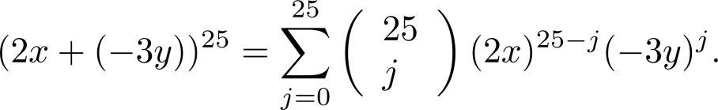
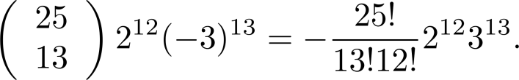
Using the Binomial Theorem
Example: What is the coefficient of x¹²y¹³ in the expansion of (2x − 3y)²⁵?
Solution: We view the expression as (2x +(−3y))²⁵. By the binomial theorem
Consequently, the coefficient of x¹²y¹³ in the expansion is obtained when j = 13.

Slide 63
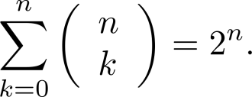
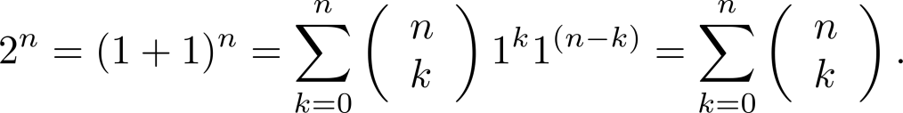
A Useful Identity
Corollary 1: If n ≥0,
Proof (using binomial theorem): With x = 1 and y = 1, from the binomial theorem we see that:

Slide 64
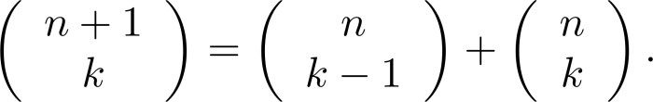
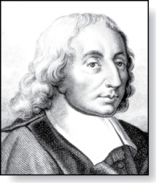
Pascal’s Identity
Pascal’s Identity: If n and k are integers with n ≥ k ≥ 0, then
Proof: Homework Exercise!
Blaise Pascal
(1623-1662)

Slide 65
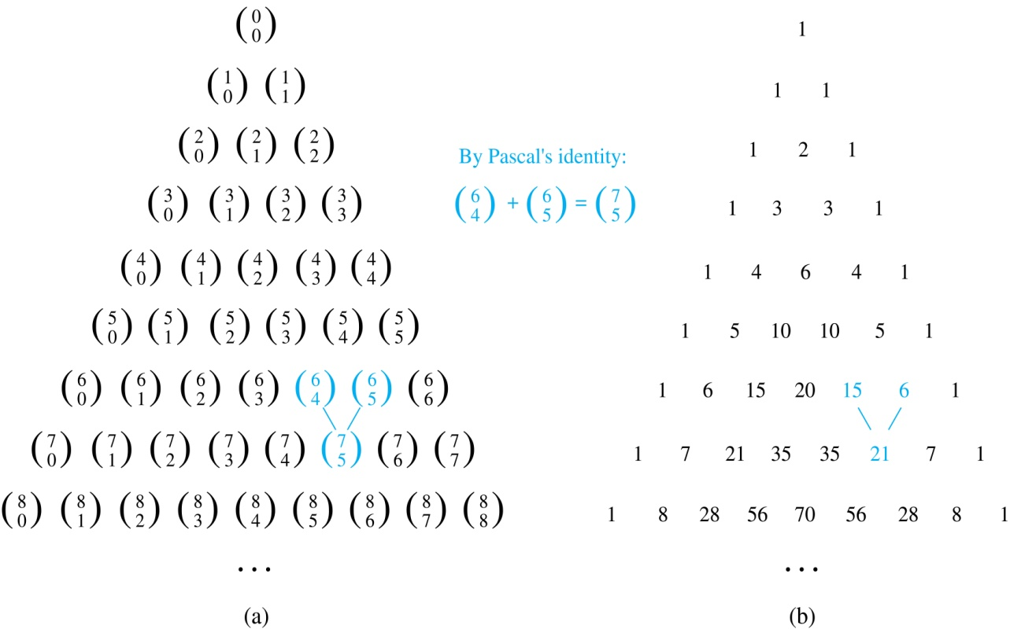

Pascal’s Triangle
The nth row in the triangle consists of the binomial coefficients
k = 0,1,….,n.
By Pascal’s identity, adding two adjacent bionomial coefficients results is the binomial coefficient in the next row between these two coefficients.

Slide 66
Summary
Product, Sum, Inclusion-Exclusion are some of the basic rules of counting
Product Rule of Counting: If a procedure can be broken down into a sequence of two tasks with n₁ and n₂ ways of doing them, then there are n₁∙n₂ ways to do the procedure
Sum Rule of Counting: If a task can be done either in one of n₁ ways or in one of n₂ ways, where none of the set of n₁ ways is the same as any of the n₂ ways, then there are n₁ + n₂ ways to do the task

Slide 67
Summary
Subtraction Rule/Inclusion-Exclusion Principle: If a task can be done either in one of n₁ ways or in one of n₂ ways, then the total number of ways to do the task is n₁ + n₂ minus the number of ways to do the task that are common to the two different ways
The Pigeonhole Principle is a very generic rule on assignments and has tremendously wide applications

Slide 68
Summary
The Generalized Pigeonhole Principle: If N objects are placed into k boxes, then there is at least one box containing at least ⌈N/k⌉ objects
Permutations and Combinations are used to solve counting problems
A permutation of a set of distinct objects is an ordered arrangement of these objects. An ordered arrangement of r elements of a set is called an r-permutation

Slide 69
Summary
If n and r are integers with 1 ≤ r ≤ n, then the number of r-permutations P(n, r) = n!/(n-r)!
An r-combination of elements of a set is an unordered selection of r elements from the set. It is a subset of the set with r elements
The number of r-combinations of a set with n elements, where n ≥ r ≥ 0, is C(n, r) = n!/(r!(n-r)!)
C(n, r) = C(n, n-r)

Slide 70
Summary
We can use counting principles to find the coefficients in the expansion of (x + y)^{n} where n is a positive integer

